Slide 1
Operations Management and Quality Enhancement
Dr. Ronald K. Satterfield
Muma College of Business
University of South Florida

Slide 2
Math Optimization
Dr. Ronald K. Satterfield
Muma College of Business
University of South Florida
Getting the Most for the Least
Or the Least for the Most

Slide 3



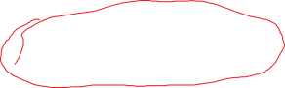
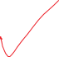

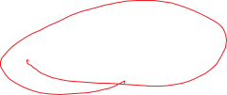
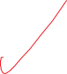
Plan for This Presentation
Introduction to Math Optimization
Historical Origins
What Are We Trying To Do?
Example Model and Solution
Sensitivity Analysis
Other Model Types
Summary
Your Review

Slide 4
Math Optimization
Area of Quantitative Analysis
“Optimizing” a Problem
About 70 Years Old
Common Today, But Not Many Know About It
Spreadsheet Approach
Introduction | Model Structure | Formulation | Calculated Solution | Graphical Solution
Refining | Sensitivity Analysis | Other Model Types | Summary | Your Review

Slide 5
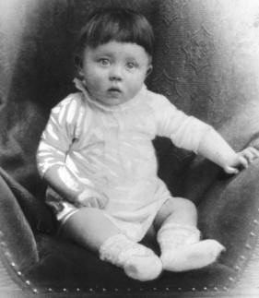
Introduction | Model Structure | Formulation | Calculated Solution | Graphical Solution
Refining | Sensitivity Analysis | Other Model Types | Summary | Your Review

Slide 6
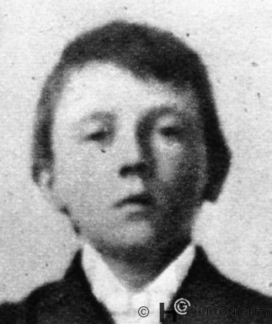
Introduction | Model Structure | Formulation | Calculated Solution | Graphical Solution
Refining | Sensitivity Analysis | Other Model Types | Summary | Your Review

Slide 7
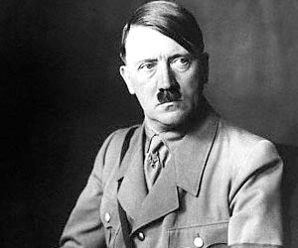
Introduction | Model Structure | Formulation | Calculated Solution | Graphical Solution
Refining | Sensitivity Analysis | Other Model Types | Summary | Your Review

Slide 8
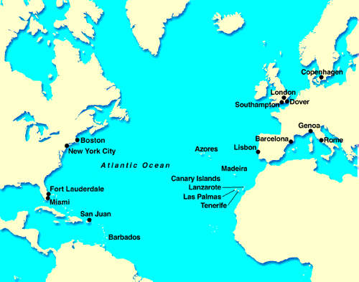
Introduction | Model Structure | Formulation | Calculated Solution | Graphical Solution
Refining | Sensitivity Analysis | Other Model Types | Summary | Your Review

Slide 9
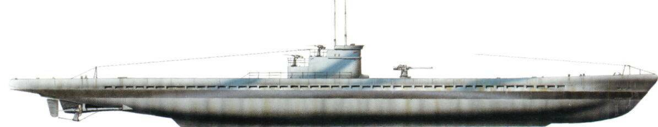
Introduction | Model Structure | Formulation | Calculated Solution | Graphical Solution
Refining | Sensitivity Analysis | Other Model Types | Summary | Your Review

Slide 10









Introduction | Model Structure | Formulation | Calculated Solution | Graphical Solution
Refining | Sensitivity Analysis | Other Model Types | Summary | Your Review

Slide 11
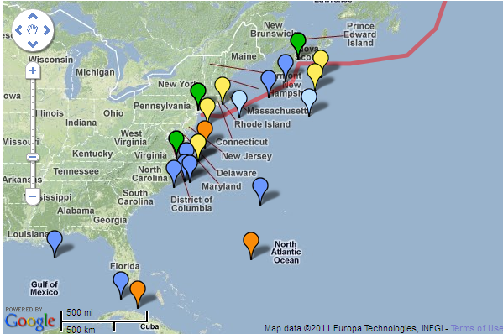
Introduction | Model Structure | Formulation | Calculated Solution | Graphical Solution
Refining | Sensitivity Analysis | Other Model Types | Summary | Your Review

Slide 12
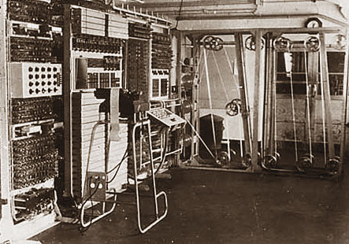
Colossus
Introduction | Model Structure | Formulation | Calculated Solution | Graphical Solution
Refining | Sensitivity Analysis | Other Model Types | Summary | Your Review

Slide 13
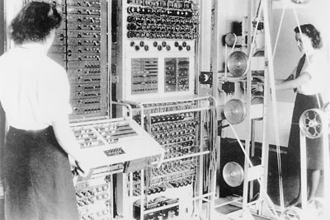
Colossus
Introduction | Model Structure | Formulation | Calculated Solution | Graphical Solution
Refining | Sensitivity Analysis | Other Model Types | Summary | Your Review

Slide 14
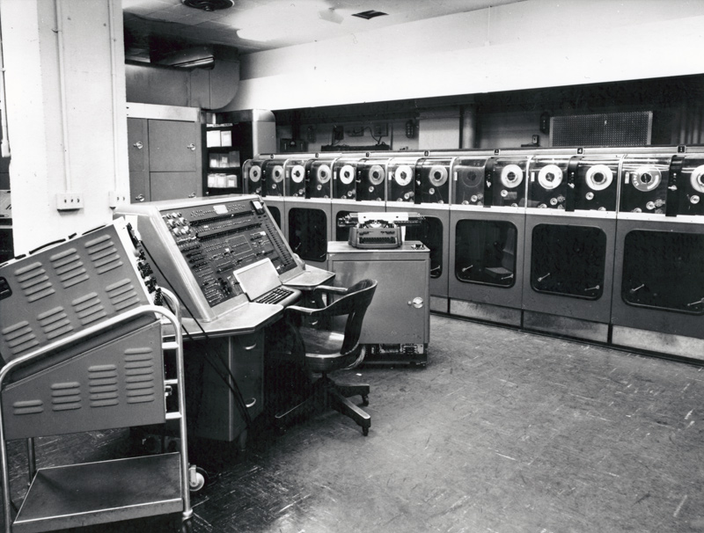
UNIVAC I & II
Universal Automatic Computer
Introduction | Model Structure | Formulation | Calculated Solution | Graphical Solution
Refining | Sensitivity Analysis | Other Model Types | Summary | Your Review

Slide 15
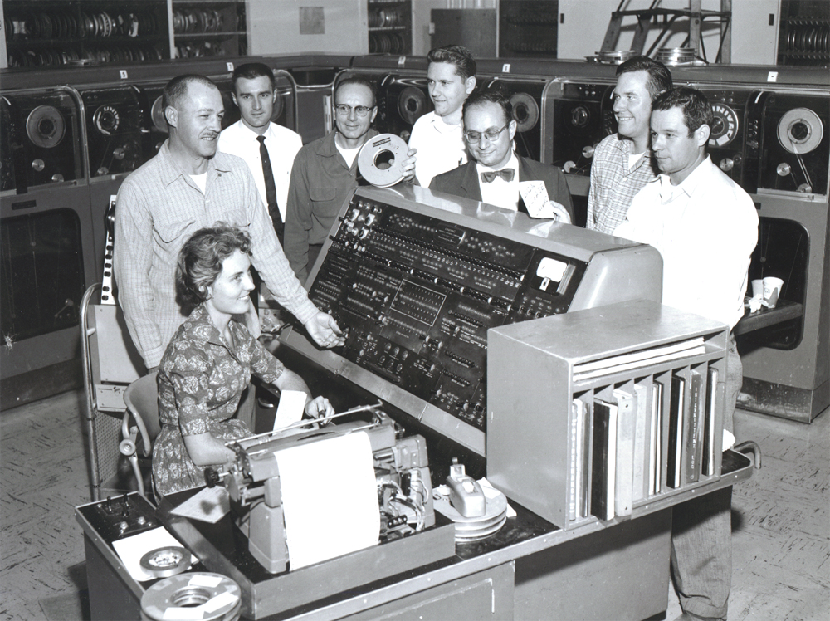
UNIVAC I & II
Universal Automatic Computer
Introduction | Model Structure | Formulation | Calculated Solution | Graphical Solution
Refining | Sensitivity Analysis | Other Model Types | Summary | Your Review

Slide 16
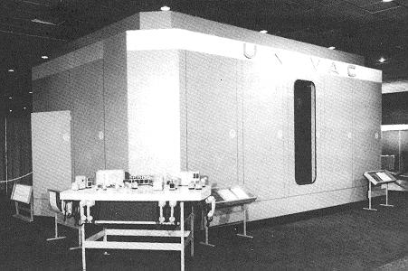
UNIVAC I & II
Universal Automatic Computer
Introduction | Model Structure | Formulation | Calculated Solution | Graphical Solution
Refining | Sensitivity Analysis | Other Model Types | Summary | Your Review

Slide 17
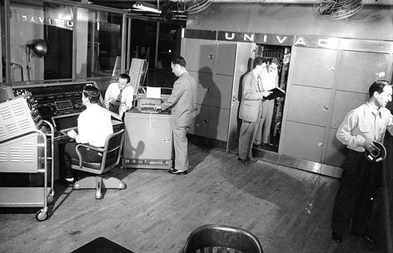
UNIVAC I & II
Universal Automatic Computer
Introduction | Model Structure | Formulation | Calculated Solution | Graphical Solution
Refining | Sensitivity Analysis | Other Model Types | Summary | Your Review

Slide 18
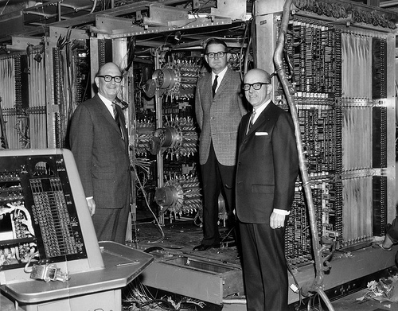
UNIVAC I & II
Universal Automatic Computer
Introduction | Model Structure | Formulation | Calculated Solution | Graphical Solution
Refining | Sensitivity Analysis | Other Model Types | Summary | Your Review

Slide 19
Kinds of Optimization
Linear Optimization
Integer Optimization
Mixed Integer Optimization
Goal Optimization
Network Optimization
Introduction | Model Structure | Formulation | Calculated Solution | Graphical Solution
Refining | Sensitivity Analysis | Other Model Types | Summary | Your Review

Slide 20
Uses for Optimization
Resource Allocation
Workforce Scheduling
Master Production Scheduling
Inventory Planning
Warehouse Location
Truck Routing
Airline Scheduling
Product Blending
Introduction | Model Structure | Formulation | Calculated Solution | Graphical Solution
Refining | Sensitivity Analysis | Other Model Types | Summary | Your Review

Slide 21
What is Solver?
Third-Party Add-In with Excel
All Excel Installations Have It
Basic Version
Fuller Version for Purchase
Introduction | Model Structure | Formulation | Calculated Solution | Graphical Solution
Refining | Sensitivity Analysis | Other Model Types | Summary | Your Review

Slide 22



A Mathematical Model
Subject to:
Introduction | Model Structure | Formulation | Calculated Solution | Graphical Solution
Refining | Sensitivity Analysis | Other Model Types | Summary | Your Review

Slide 23
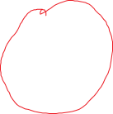



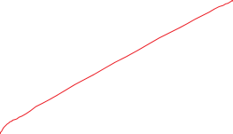
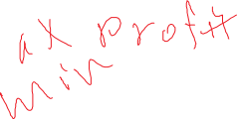

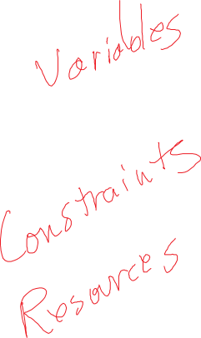


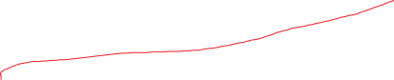
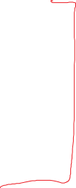



A Mathematical Model
Subject To:
Introduction | Model Structure | Formulation | Calculated Solution | Graphical Solution
Refining | Sensitivity Analysis | Other Model Types | Summary | Your Review

Slide 24


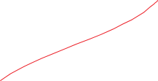
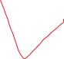

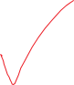


Formulating a Model
What are you trying to achieve?
How do you achieve it?
What are the resources used?
How are the resources used?
What are the resource limits?
Introduction | Model Structure | Formulation | Calculated Solution | Graphical Solution
Refining | Sensitivity Analysis | Other Model Types | Summary | Your Review

Slide 25



An Example
A farmer in Iowa can plant corn or wheat this year. Each acre of wheat yields $2500 in profit, requires 6 labor hours, and 2 tons of fertilizer. Each acre with corn yields $3200 in profit and requires 4 tons of fertilizer and 4 labor hours. The farmer has six employees each working 1000 hours through the growing season, and 3500 tons of fertilizer.
Introduction | Model Structure | Formulation | Calculated Solution | Graphical Solution
Refining | Sensitivity Analysis | Other Model Types | Summary | Your Review

Slide 26
An Example
A farmer in Iowa can plant corn or wheat this year. Each acre of wheat yields $2500 in profit, requires 6 labor hours, and 2 tons of fertilizer. Each acre with corn yields $3200 in profit and requires 4 tons of fertilizer and 4 labor hours. The farmer has six employees each working 1000 hours through the growing season, and 3500 tons of fertilizer.
Introduction | Model Structure | Formulation | Calculated Solution | Graphical Solution
Refining | Sensitivity Analysis | Other Model Types | Summary | Your Review

Slide 27
Graphical Solution
Understanding how all this works.
Introduction | Model Structure | Formulation | Calculated Solution | Graphical Solution
Refining | Sensitivity Analysis | Other Model Types | Summary | Your Review

Slide 28
Refining the Solution
The farmer has a maximum of 900 acres of land to plant this year.
Introduction | Model Structure | Formulation | Calculated Solution | Graphical Solution
Refining | Sensitivity Analysis | Other Model Types | Summary | Your Review

Slide 29
Refining the Solution
300 acres of the farmer’s land is not suitable for corn but can be used for wheat.
Introduction | Model Structure | Formulation | Calculated Solution | Graphical Solution
Refining | Sensitivity Analysis | Other Model Types | Summary | Your Review

Slide 30
Refining the Solution
The farmer has an opportunity to rent up to 500 acres of additional land at a nominal cost. How much land should be rented?
Introduction | Model Structure | Formulation | Calculated Solution | Graphical Solution
Refining | Sensitivity Analysis | Other Model Types | Summary | Your Review

Slide 31
Refining the Solution
The farmer can also add soybeans as a possible third crop. Each acre of soybeans yields $2000 in profit, requires 5 labor hours, and 2 ½ tons of fertilizer.
Introduction | Model Structure | Formulation | Calculated Solution | Graphical Solution
Refining | Sensitivity Analysis | Other Model Types | Summary | Your Review

Slide 32
Sensitivity Analysis
Introduction | Model Structure | Formulation | Calculated Solution | Graphical Solution
Refining | Sensitivity Analysis | Other Model Types | Summary | Your Review

Slide 33
Other Model Types
Introduction | Model Structure | Formulation | Calculated Solution | Graphical Solution
Refining | Sensitivity Analysis | Other Model Types | Summary | Your Review

Slide 34
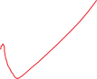

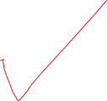

Summary
Introduction to Math Optimization
Historical Development
How to formulate a model
Solution with Solver
Graphical Solution
Adding Variables & Constraints
Sensitivity Analysis
Several Other Model Types and Constraints
Introduction | Model Structure | Formulation | Calculated Solution | Graphical Solution
Refining | Sensitivity Analysis | Other Model Types | Summary | Your Review

Slide 35
Your Review
Practice
Practice
Practice
Introduction | Model Structure | Formulation | Calculated Solution | Graphical Solution
Refining | Sensitivity Analysis | Other Model Types | Summary | Your Review

